Slide 1


Web scraping to gain company insights
23-09-2024

Slide 2
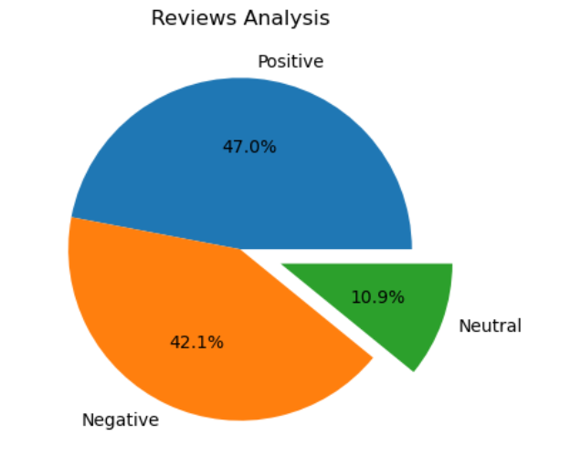
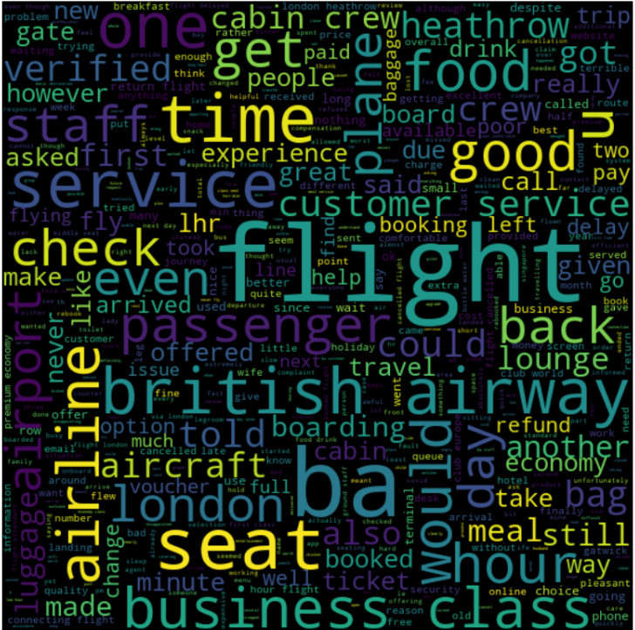
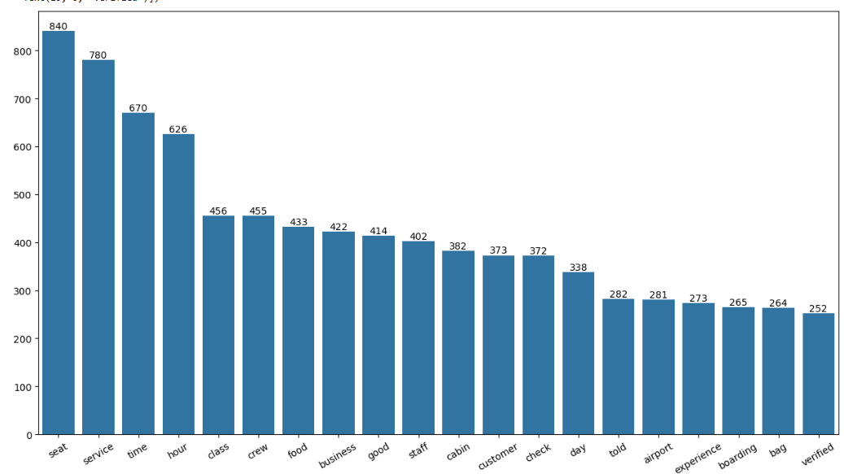
INSIGHTS FROM CUSTOMER REVIEWS
From cleaning 1000 reviews given by the customers, we obtained
Positive Reviews - 470
Negative Reviews - 421
Neutral Reviews – 109
Word cloud of keywords used in reviews

